Slide 1
BDD 101

Slide 2
1.
What the heck?
Isn’t TDD enough?

Slide 3
Write a failing test
Make the test pass
Refactor
Notes:
the idea is not to write a failing test. What you’re trying to do is imagine what the next step you want to make is to evolve the implementation that you need to deliver value. It’s quite often rewritten as ‘writing the next specification’.
The second step is to make it pass quickly. The intention here is not to get the best design; it’s to get them all to green quickly, because now they’re all green, you can look at them and go ‘how do I want to improve this design?’ and you can safely improve the design through the refactoring.
The third thing is refactoring. The refactor loop in Nat and Steve’s book is actually a cycle. You can draw it many other ways, but the idea is you don’t just go in and refactor and you’re done; you go in, you look and see what you would like to change and change it. You make sure the test is still green and you look at it again and say ‘is there another change that I want to do?’ or ‘has that refactoring introduced another thing that I want to do?’. This is a multi-process in itself; it’s not a single step.

Slide 4
Sounds good
Help you to write reliable code
Prevent overkill
Cover 100% of the code
Each test is independent, tests can be isolated

Slide 5
But…
It is difficult to write tests first if you don’t know how to resolve a problem
Program can have a poor value
In practice, test dependences exist
Too close to implementation
Notes:
if it does not follow customer needs
and it is a hell to untangle them
, refactoring will cost many tests rewriting

Slide 6
Behaviour Driven Development
Notes:
Behaviour Driven Development is an extension of test-driven development
Shifting from thinking in test to behaviour
Can collaborate it BA, QA, Developer
Natural language

Slide 7
BDD in a nutshell
Focus on business value
Improve collaboration → BA, QA, Dev
Ubiquitous Language
Test only behaviours
No need to change assertions if implementation change
Notes:
, not implementation

Slide 8
TDD: Building the thing right
BDD: Building the right thing

Slide 9
2.
How to do it?
Learn the mantra

Slide 10

Given
When Then
Notes:
Given a context
When an event happens
Then an outcome should occur

Slide 11
From story to scenario
Story
As a user
I want to be able to see card that contains argument and total like
So that I can know the argument in retro
Scenario
Given user already login
And card is available
When user open retro
Then user should see card that contains argument and total like

Slide 12
From story to scenario
Story
As a user
I want to be able to delete an existing card in a section
So that I can help remove the false argument
Scenario
Given user already login
And card is available
When user open retro
And click on delete
button on card
Then deleted card should be removed

Slide 13

Tools
Notes:
Gherkin is the format for cucumber specifications
Gherkin is line-oriented language just like YAML and Python
Gherkin Scripts connects the human concept of cause and effect to the software concept of input/process and output
Feature, Background, Scenario, Given, When, Then, And But are importantly used in Gherkin
In Gherkin cucumber, each scenario should execute separately
The biggest advantage of Gherkin is simple enough for non-programmers to understand
It may not work well in all type of scenarios
Cucumber is a testing framework for behavior driven development. It works by allowing you to define your tests in Gherkin form, and makes these gherkins executable by tying them to code.
Gherkin is the Domain Specific Language (DSL) that is used for writing Cucumber tests. It allows for test scripts to be written in a human readable format, which can then be shared between all of the stakeholders in the product development.

Slide 14
3.
Implementation
Let's get our hands dirty

Slide 15
FizzBuzz
Write a program that print inputted number.
If the number is multiples of 3 print “Fizz”
and for the multiples of 5 print “Buzz”.
For the multiples of both print “FizzBuzz”

Slide 16
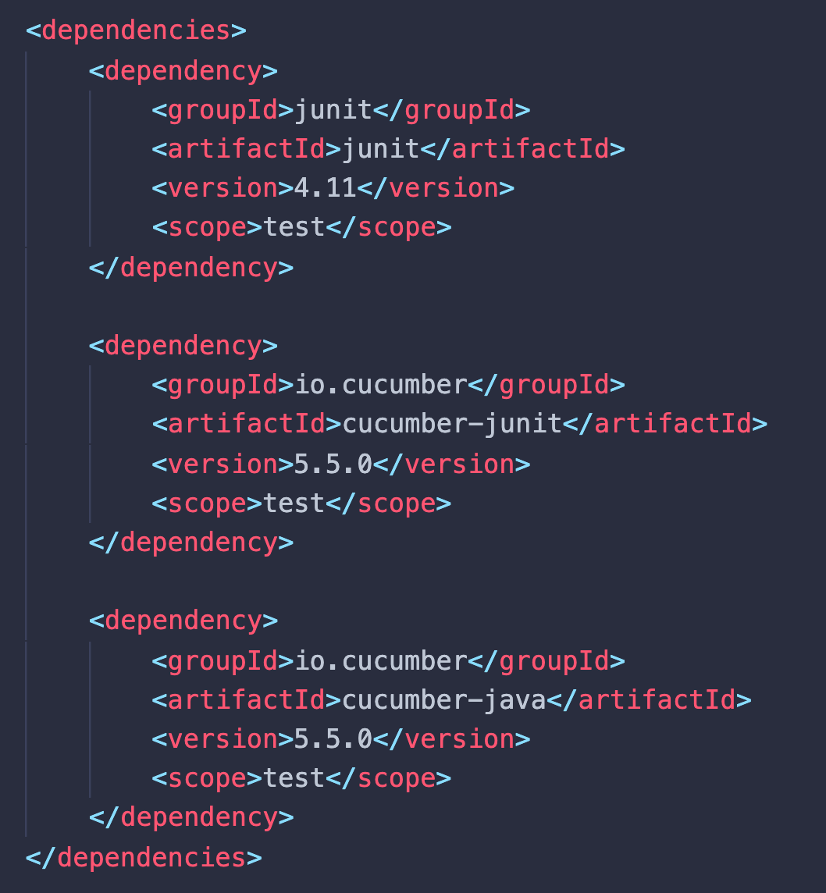

Slide 17
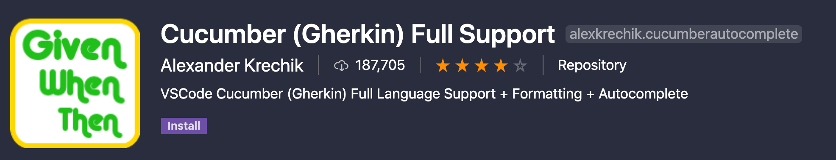

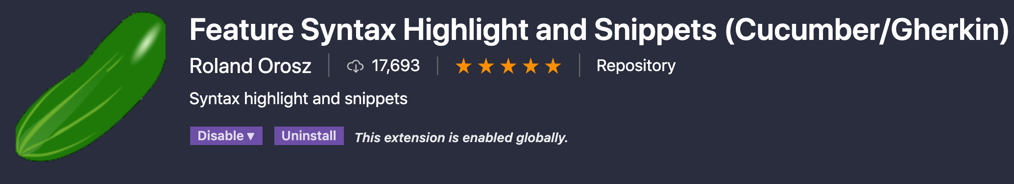

Slide 18
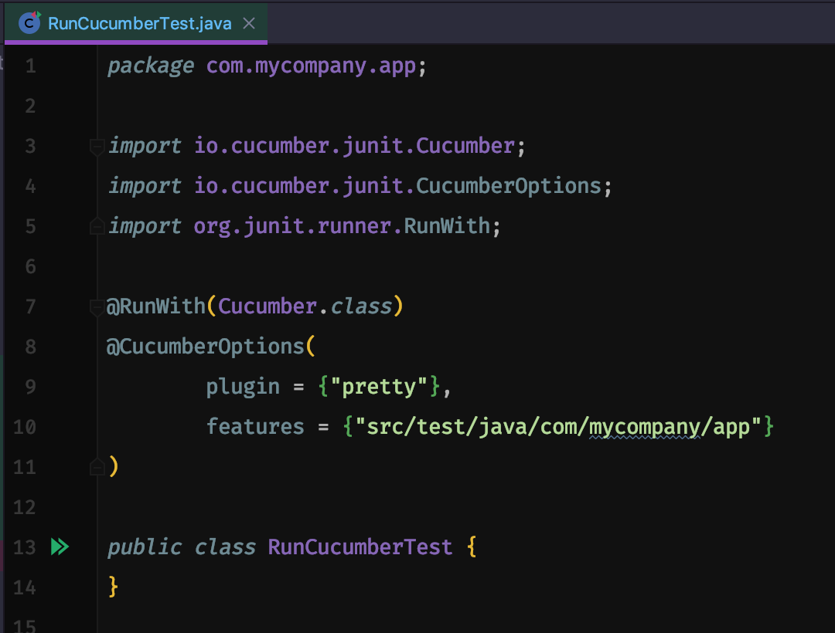

Slide 19
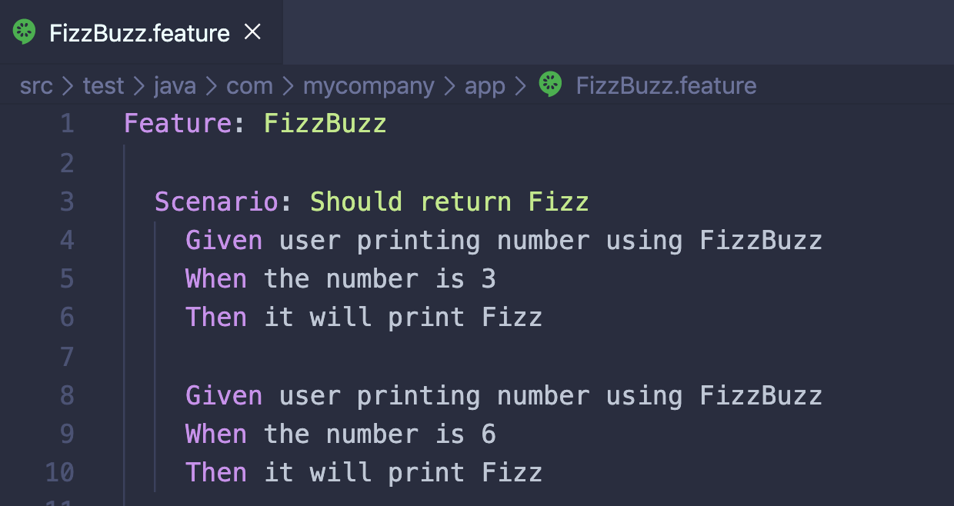

Slide 20
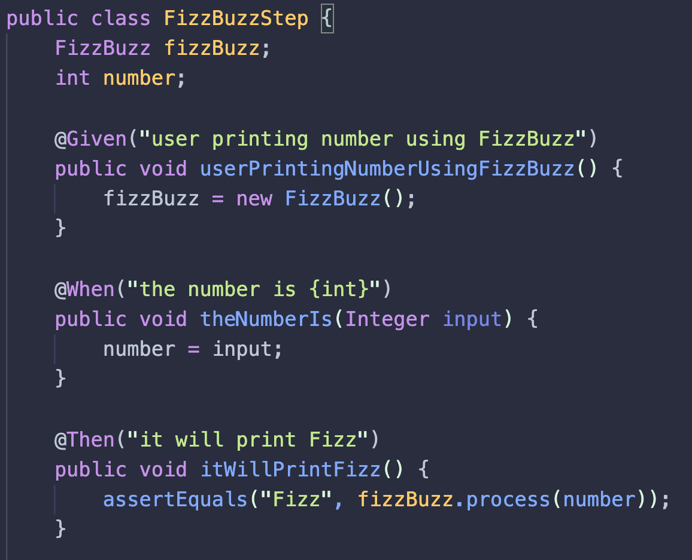

Slide 21
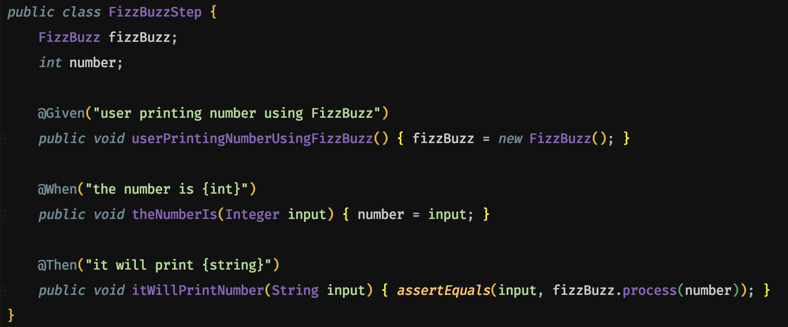

Slide 22
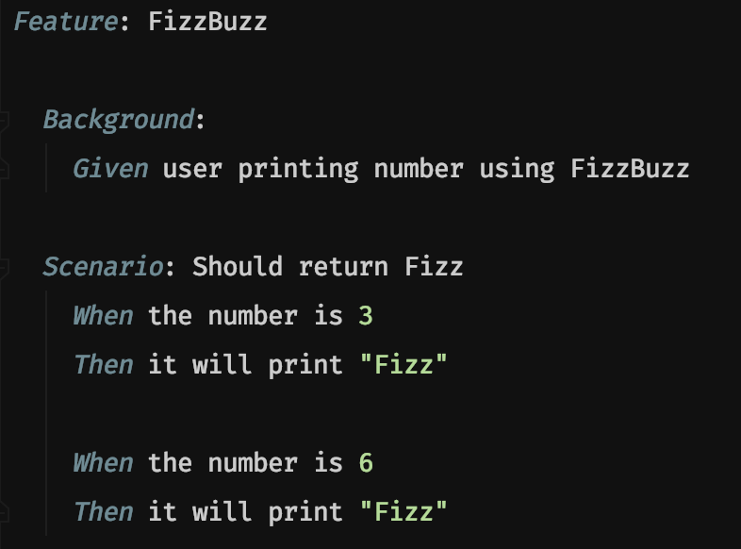

Slide 23
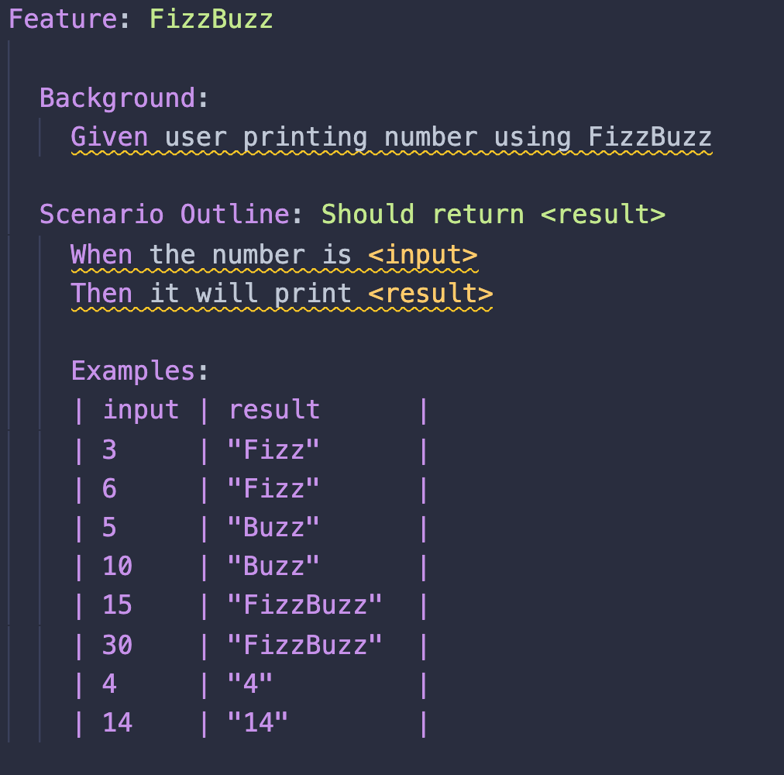

Slide 24
Complete solution
https://github.com/depimomo/fizzbuzz-bdd

Slide 25
4.
For your information

Slide 26
Misconception
Many developers treat BDD like TDD. Rather than using it as an opportunity to communicate with product owners, they write the tests in isolation and then write the code necessary to make the tests pass — the same as they would with TDD tests.
Notes:
If you treat BDD like TDD, then you’re probably missing out on most of the benefits. BDD is designed to improve communication between business and technical teams. If there’s no communication, these tests become a redundant form of TDD with little benefit. But, how should you involve business teams?
Let’s take a look at where business teams fit into the BDD process, and in particular, who should write the BDD scenarios to realize the greatest benefit.

Slide 27
The Three Amigos
(￣▽￣*)ゞ
Product owners → help the scenarios remain relevant to business value.
Notes:
scope of the application, including the translation of user stories into features and the acceptance/rejection of features.

Slide 28
The Three Amigos
ψ( ` ∇ ´ )ψ
Developers → describe the scenarios precisely enough to be able to deliver the features that the business folks are asking for.
Notes:
adding steps to the scenarios and reason through the details. They ask questions like, “How will the application work?” and “What are the potential technical roadblocks behind the scenes?”.

Slide 29
The Three Amigos
(＃￣ω￣)
Test engineers → find the things that everyone else misses that would make our users make fun of us on Twitter.
Notes:
generating scenarios and thinking through the edge cases. They ask questions like, “how could the application break?” and “What user stories were missed in a given set of features?”.

Slide 30
References
cucumber.io/docs/guides/
sitepoint.com/bdd-javascript-cucumber-gherkin/
dzone.com/articles/guide-to-behavior-driven-development-in-java
javatpoint.com/cucumber-behavior-driven-development

Slide 31
Thanks!

